Slide 1
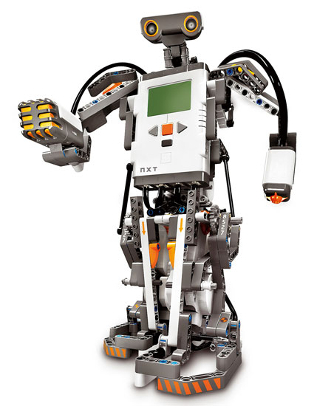
Team 8
Meeting #2

Slide 2
Gantt Chart

Slide 3
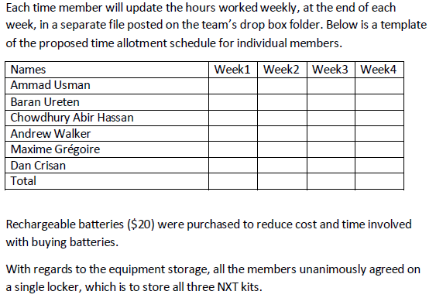
Budget review
“Documentation on week 1”

Slide 4
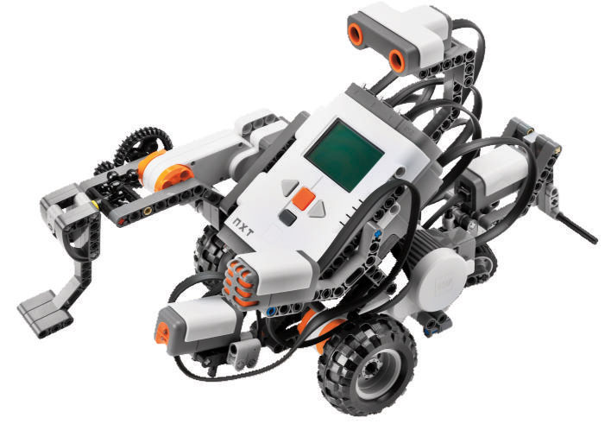
Weekly time budget
Names |  |  | Week 1 | Week 2 | Week 3 | Week 4 | Total
Ammad Usman |  |  | 5 |  |  |  | 5
Baran Ureten |  |  | 7 |  |  |  | 7
Chowdhury Abir Hassan |  |  | 6.5 |  |  |  | 6.5
Andrew Walker |  |  | 5 |  |  |  | 5
Maxime Grégoire |  |  | 5 |  |  |  | 5
Dan Crisan |  |  | 6.5 |  |  |  | 6.5
 |  | Total/week (hours) | 35 | 0 | 0 | 0 | 35

Slide 5
Time distribution
Time distribution |  | Week 1 | Week 2 | Week 3 | Week 4 | Total
Discussions and management |  | 7.5 |  |  |  | 7.5
Design |  | 8 |  |  |  | 8
Programming/Testing |  | 5 |  |  |  | 5
Documentation |  | 5 |  |  |  | 5
 | Total (hours) | 25.5 | 0 | 0 | 0 | 25.5

Slide 6
Mechanical design proposal
A few ideas… (Google and others)

Slide 7
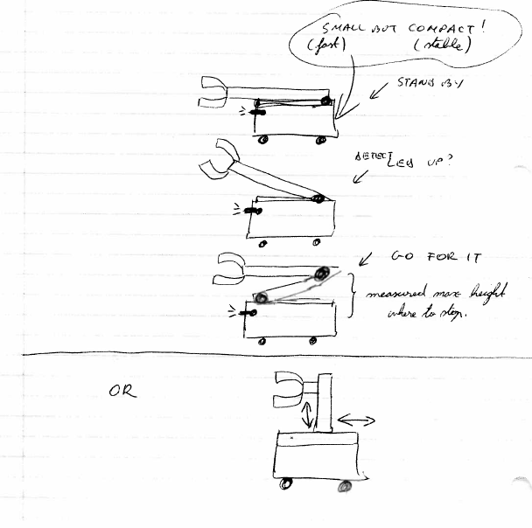

Slide 8
Presentation of adopted mechanical design
The mechanical design consists of the following:
- 2 light sensors: One for localization and one to locate the flag.
- 5 motors: 2 motors for the wheels and 3 motors to move the mechanical arm.
- 1 ultrasonic sensor mounted at the front(similar to wall following design)
The design relies on the movement of a mechanical arm, comprising of pivot points, and rotated by motors. One brick will control the mechanical arm while the other brick controls the wheels.
“Documentation on week 1”

Slide 9
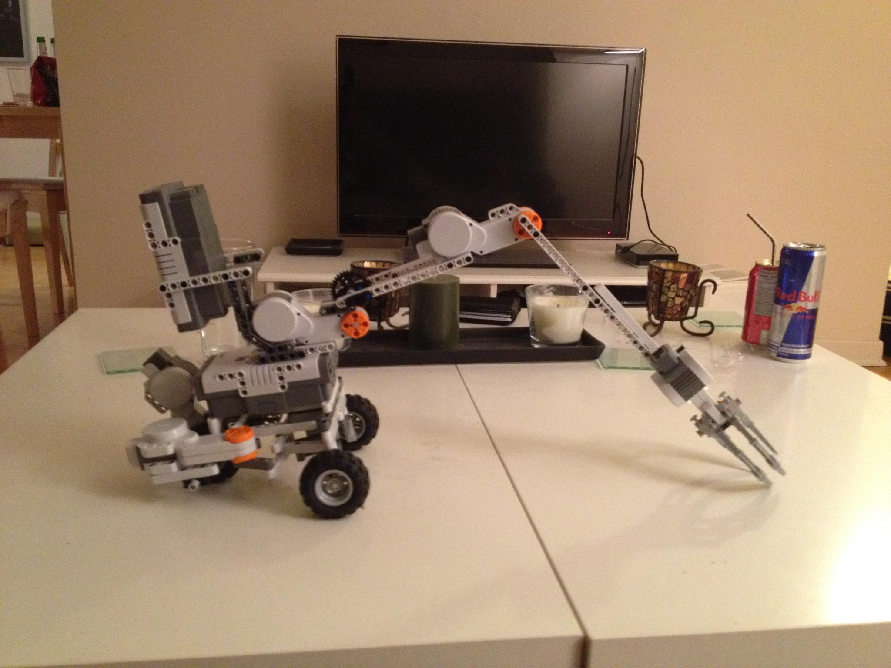

Slide 10
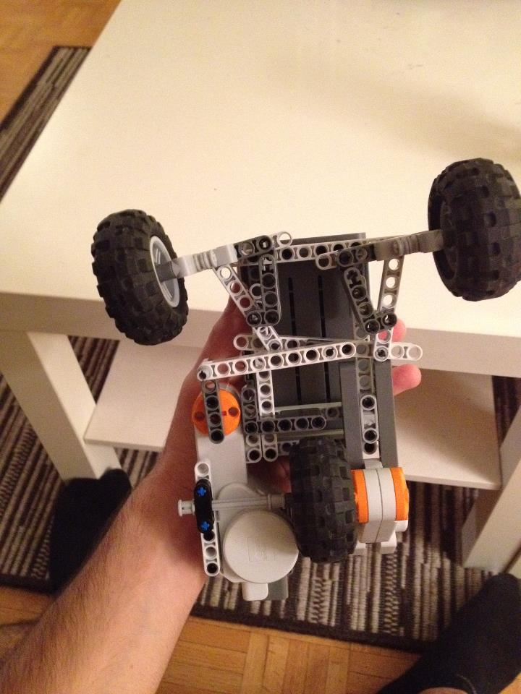
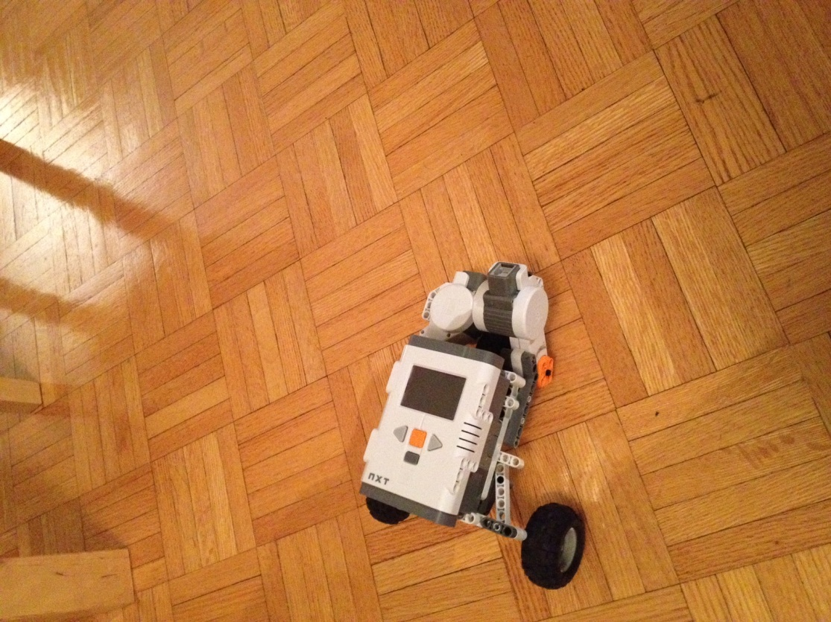
But…
Concerns: odometry and stability.

Slide 11
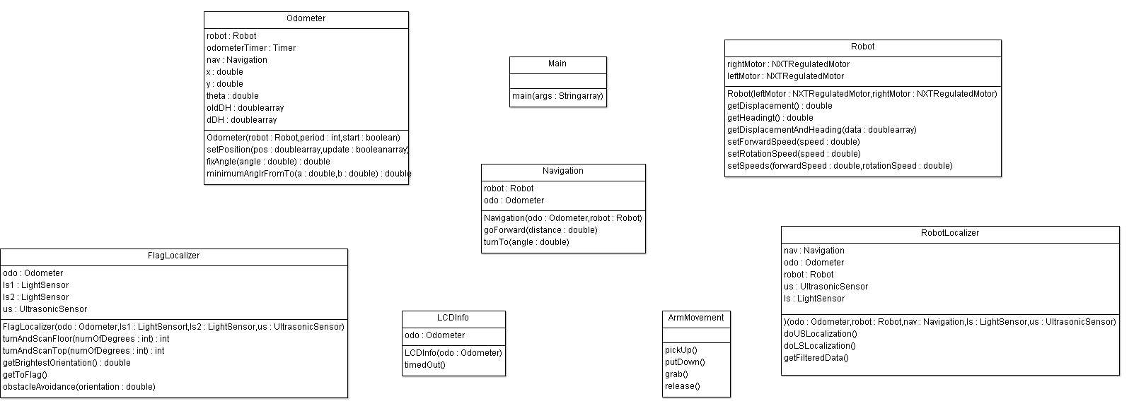
Software Architecture: class hierarchy

Slide 12
Software Architecture: preliminary API docs
.doc file

Slide 13
Inter-brick communications protocol
2 NXT bricks
Connected by a wire
One for motors
One for the arm
Side by side

Slide 14

Questions
Can we cover (hide) the light sources?
For the chart, total of hours spent as a team?
Can we use third pary source code?
Next: coding, tests, and LDD
Other…

